Slide 1
1-dars(Model Building)
Davronbek Malikov

Slide 2
Bugun
Qoidalar
Yangi oyimiz uchun plan
Model Building nima?
Model Evaluation
Model Evaluation Amaliy
Funksiya
Vazifa

Slide 3
Qoidalar

Slide 4
Darsimiz olib borish qoidalari
Tartib
2 ta ketma ket vazifa bajarilmasa gruppadan chetlashtiriladi
Vazifalarni darsimiz kunlari soat 17:00 gacha topshiringlar
Baxolash
Jami 11 ta vazifa topshirish(11*5=55)
Oraliq 50
Yakuniy 50
2 ta xaftalik tekshuruv
Imtixondan o’tish uchun 70%

Slide 5
Vazifa topshirish
Alohida repository + Xar bir vazifa uchun feedback+Xar darsdan oldin o’tgan darslar baxosini gruppada elon qilinishi

Slide 6
Model Building 1-oy
Plan

Slide 7
Model Building 1-oy
ML
Python
Model qurish(kodlar ketma ketligi emas)
Turli xil yangi algorithmlar
Ularni baxolash usullari
Evaluation qanday ishlaydi?
…….
Funksiyalar
Built in funksiyalar
……..

Slide 8
Model Building nima?

Slide 9
Model Building nima?
Algorithm(Linear Regression) – Retsept
Model ------ House Prediction

Slide 10
Model Evaluation

Slide 11
Model Evaluation
Classification
Regression
Accuracy_score, Classification report
R2, mse, rmse, mae

Slide 12
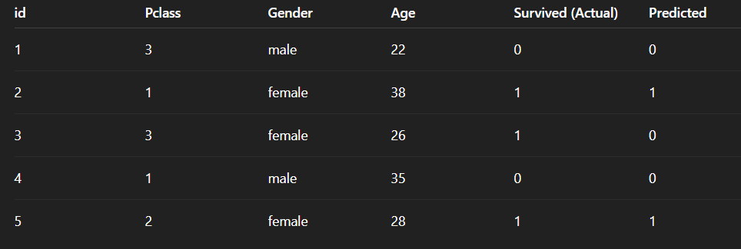
Model Evaluation: Classification(1)

Slide 13
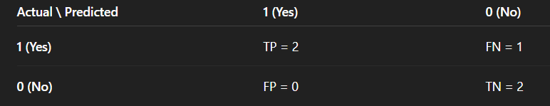
Model Evaluation: Classification(2)
Confusion Matrix

Slide 14
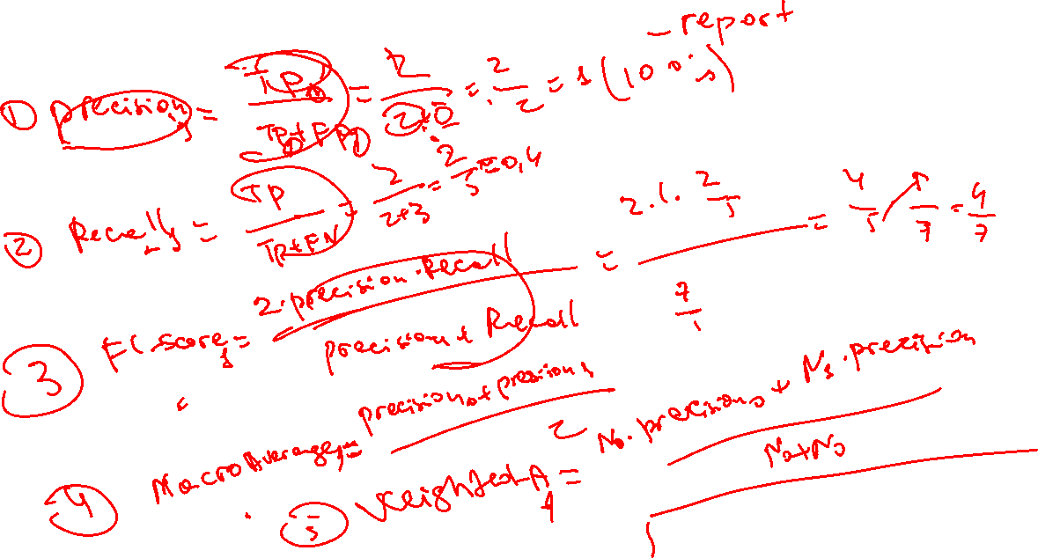
Model Evaluation: Classification

Slide 15
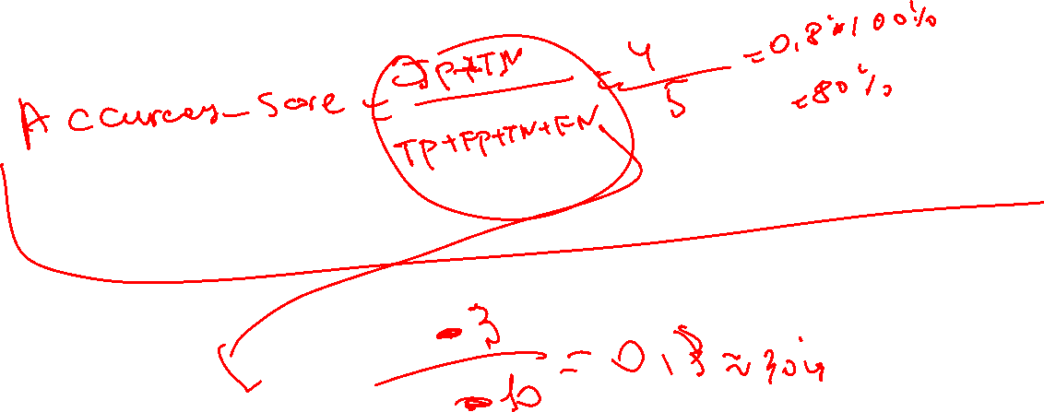
Model Evaluation: Classification

Slide 16
Model Evaluation: Classification

Slide 17
Model Evaluation Amaliy

Slide 18
Funksiya

Slide 19
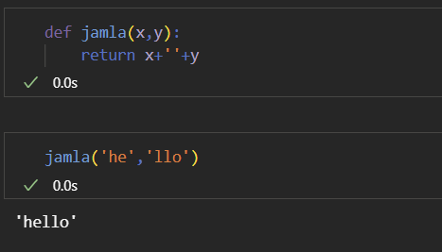
Funksiya
Qayta foydalana oladigan va biron vazifani bajaradigan kodlar blogi

Slide 20
Vazifa
1-dars uchun report yozing
Classification reportni boshqa kichik dataset orqali xar bir qismini xisoblang va koding bn tekshiring. Xisoblashlar ruchka va varoqda bolsin!
Classificationga bilgan algorithmiz bn model yasang
Funksiyaga oid berilgan misollarni ishlang

